Slide 1
Understanding Operating System Configurations
Lesson 2

Slide 2
Objectives
Skill/Concept | Exam Objective | Objective Number
Understanding User Accounts | Configure user account control (UAC) | 3.2
Configuring and Optimizing User Account Control (UAC) | Configure user account control (UAC) | 3.2
Configuring Windows 10 | Configure Control Panel options Configure desktop settings Understand libraries | 1.1 1.2 4.4
Configuring Hyper-V | None | None

Slide 3
User Accounts (1/3)
A collection of information that defines:
Actions that can be taken on a computer
Files and folders can be accessed (rights, policies, and permissions)
Keeps track of user preferences, such as the desktop background, window color, and screen saver.
Notes:
Several users can share a computer each user should have his own account. With separate accounts, each user can personalize her desktop, keep her files and settings protected from other users, and so on.

Slide 4
User Accounts (2/3)
Types of user accounts in Windows 10:
Administrator
Standard user
Guest
Elevated permissions generally refer to administrative-level permissions. Using an Administrator account for ordinary (standard-level) computing tasks leaves the computer at a much greater risk of attack.
Notes:
Administrator: Provides the broadest permissions and the most control over the computer; includes changing all settings, installing programs, and modifying the Windows registry.
Standard user: Fewer permissions than an administrative-level account but enough permissions to be productive; best used for day-to-day work.
Guest: An account with few permissions and no password that allows a user to use a computer without requiring a unique user account.

Slide 5
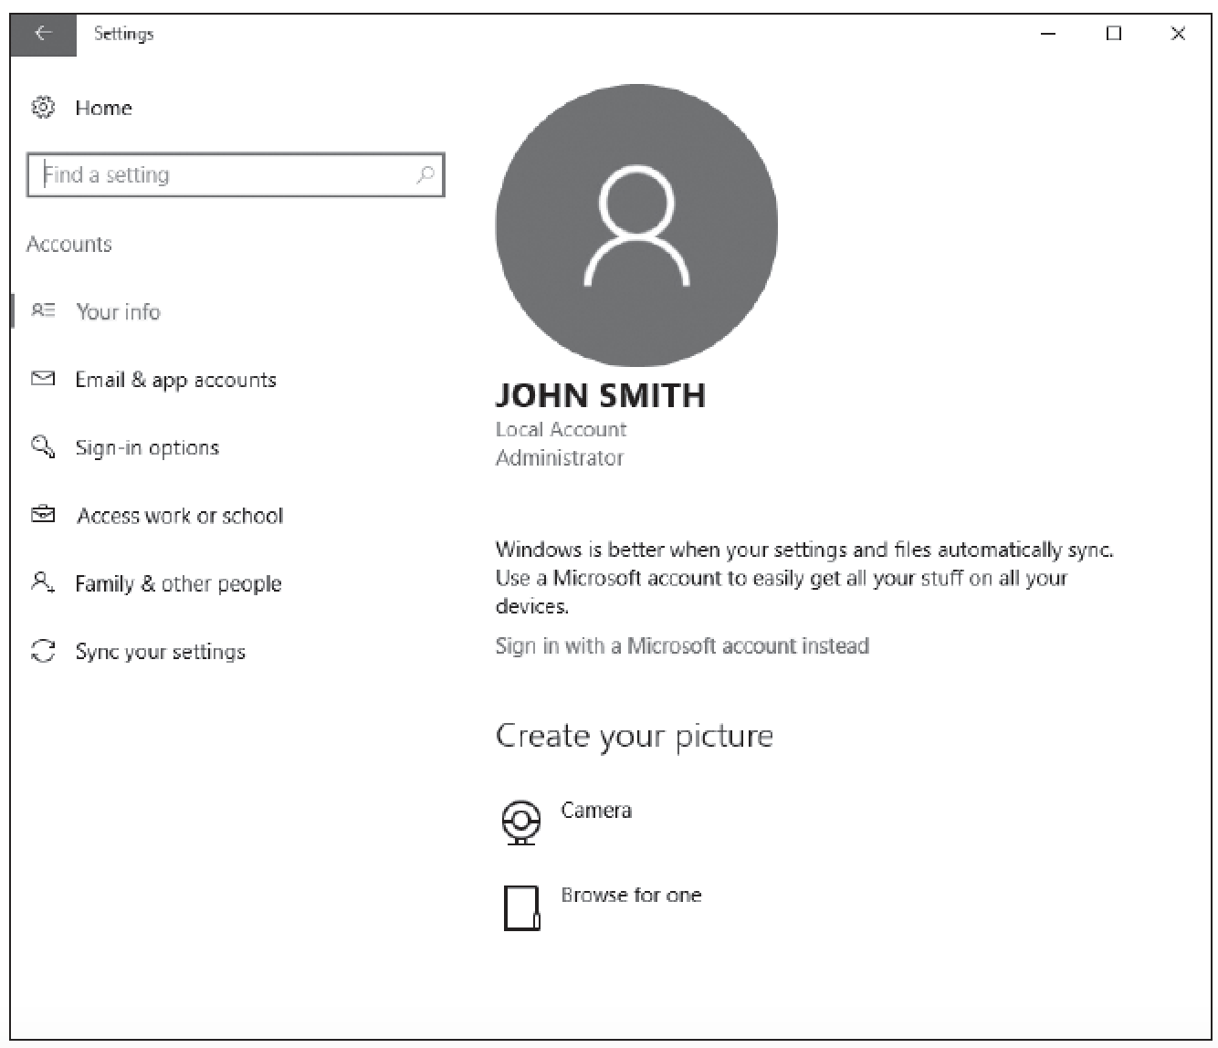
User Accounts (3/3)

Slide 6
User Account Control
User Account Control (UAC) is a technology used with Windows Vista, 7, 8/8.1, and 10 to enhance system security by detecting and preventing unauthorized changes to the system.
Some applications might not run properly using a standard user credential if the application needs to access restricted files or registry locations.

Slide 7
User Account Control Prompts/Levels (1/2)
In Windows 10, four UAC settings are available through Control Panel:
Always notify me
Notify me only when apps try to make changes to my computer (default)
Notify me only when apps try to make changes to my computer (do not dim my desktop)
Never notify me

Slide 8
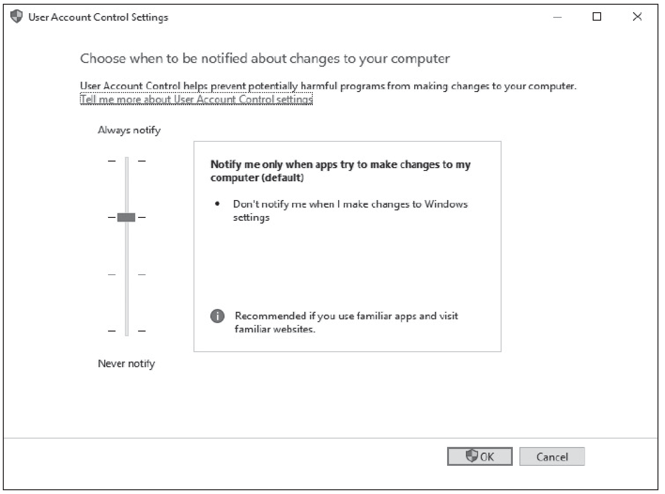
User Account Control Prompts/Levels (2/2)

Slide 9
Desktop and Recycle Bin (1/2)
The desktop is the main screen area that you see when you first start the computer and log on to Windows. Like the top of an actual desk, it is where you perform your work by opening and running one or more applications.
The desktop also includes the Recycle Bin, which is used to recover files that have been previously deleted.

Slide 10
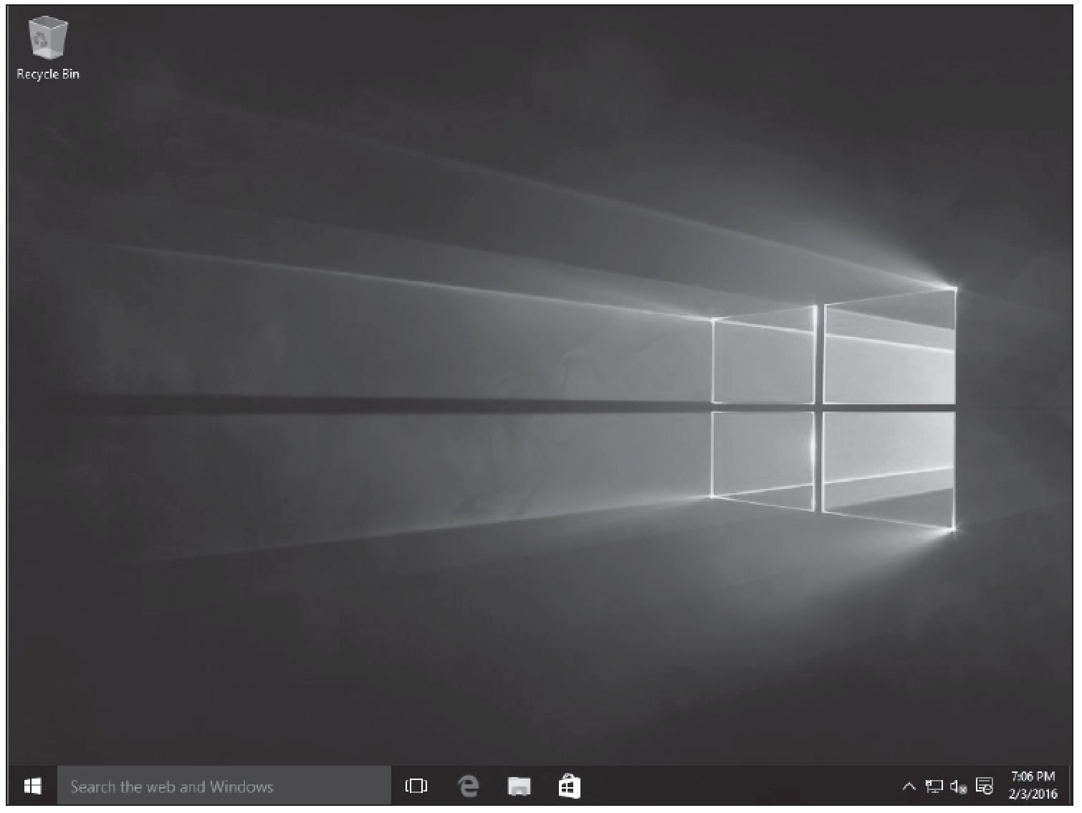
Desktop and Recycle Bin (2/2)

Slide 11
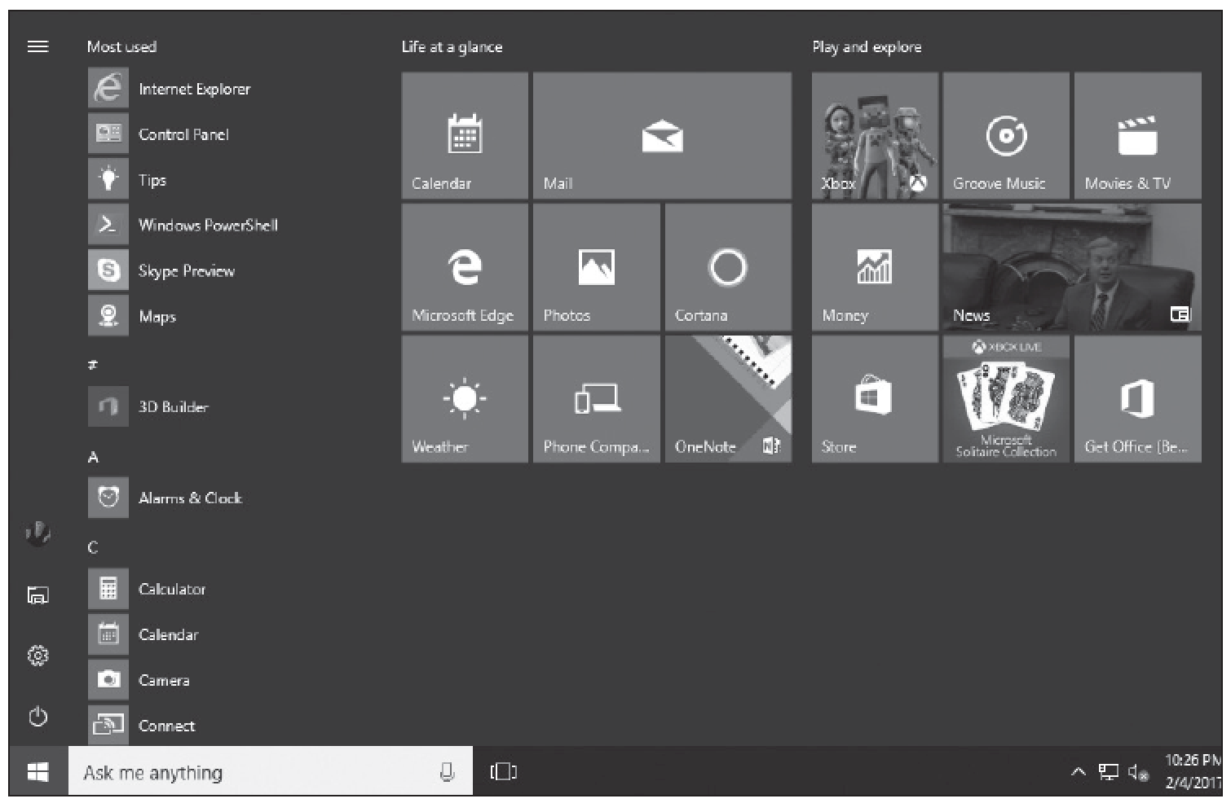
Windows 10 Start Menu

Slide 12
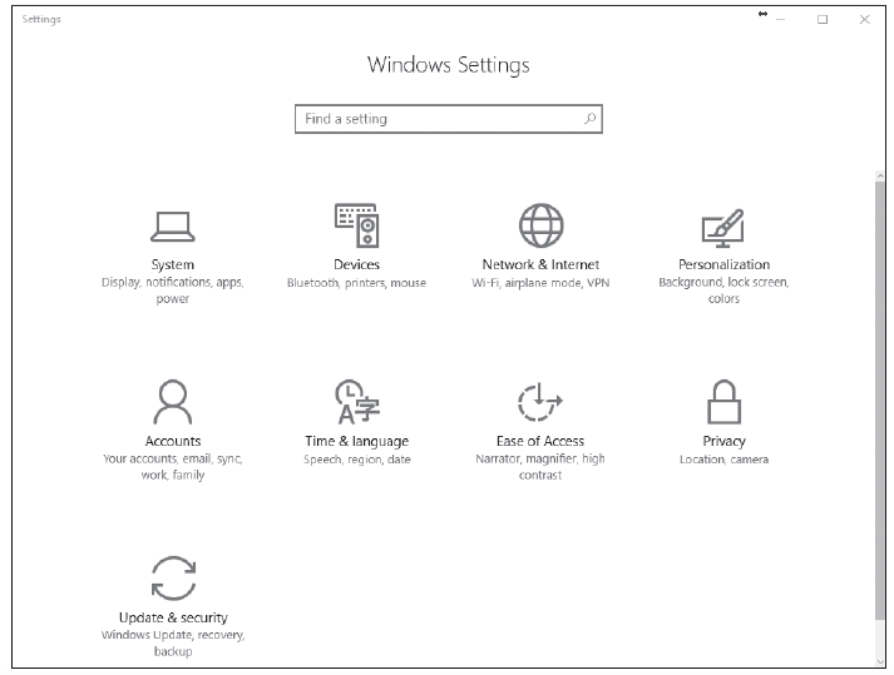
Windows Settings

Slide 13
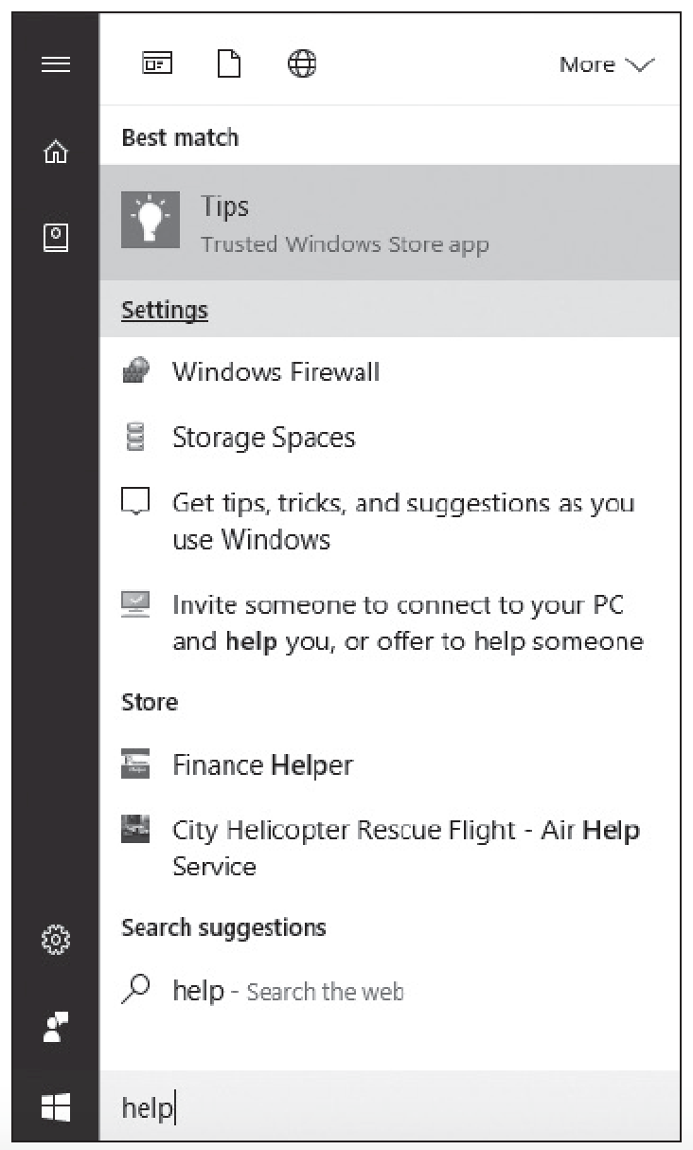
Cortana

Slide 14
Control Panel (1/2)
Prior to Windows 10, Control Panel was the primary graphical utility to configure the Windows environment and hardware devices.
In Windows 10, it can be accessed by right-clicking the Start button and choosing Control Panel.
Each category includes a top-level link; under this link are several of the most frequently performed tasks for the category.

Slide 15
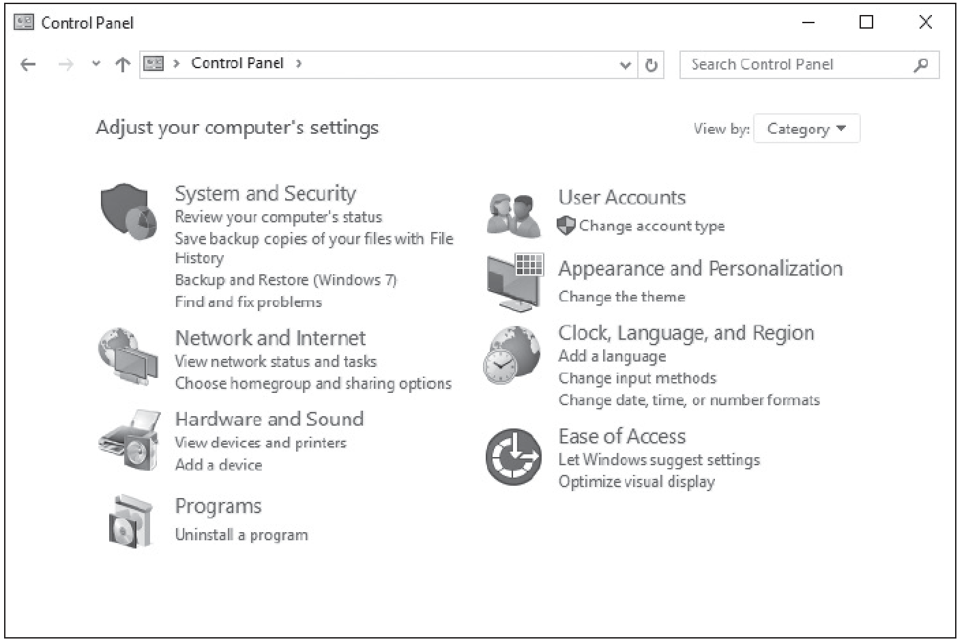
Control Panel (2/2)

Slide 16
Administrative Tools
Administrative Tools is a folder in Control Panel that contains tools for system administrators and advanced users.
To access the Administrative Tools, right-click Start and choose Control Panel. Click System and Security > Administrative Tools while in Category view or click Administrative Tools while in icons view.

Slide 17
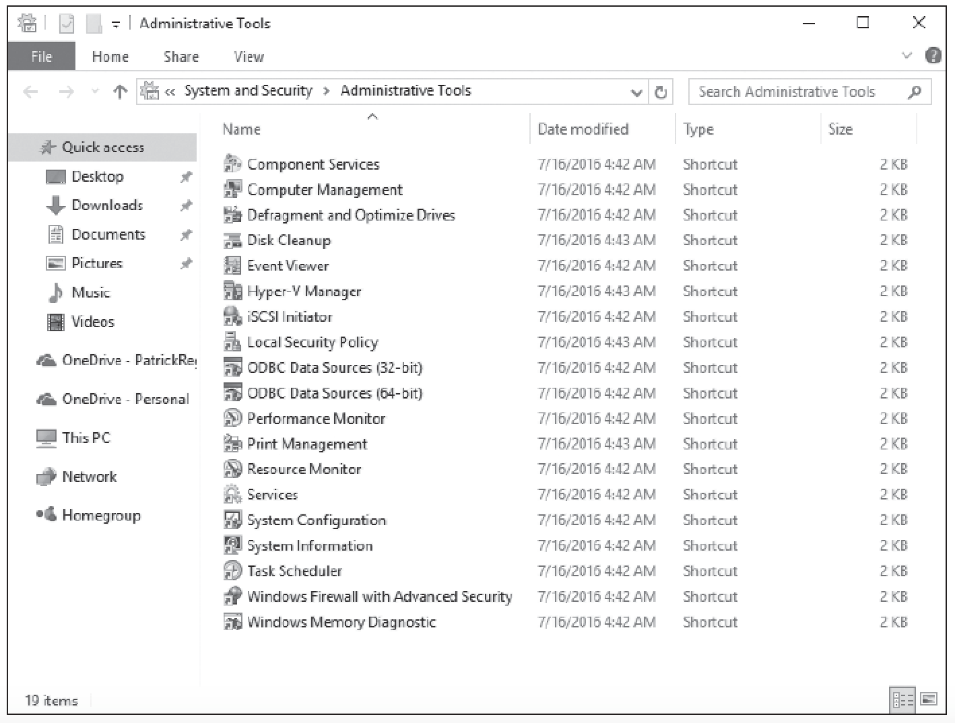
Administrative Tools Folder

Slide 18
Configuring System Options (1/2)
Some of the most important configuration settings for a user are the system settings within Control Panel.
These include gathering generation information about your system, changing the computer name, adding the computer to a domain, accessing the Device Manager, configuring remote settings, configuring startup and recovery options, and configuring overall performance settings.

Slide 19
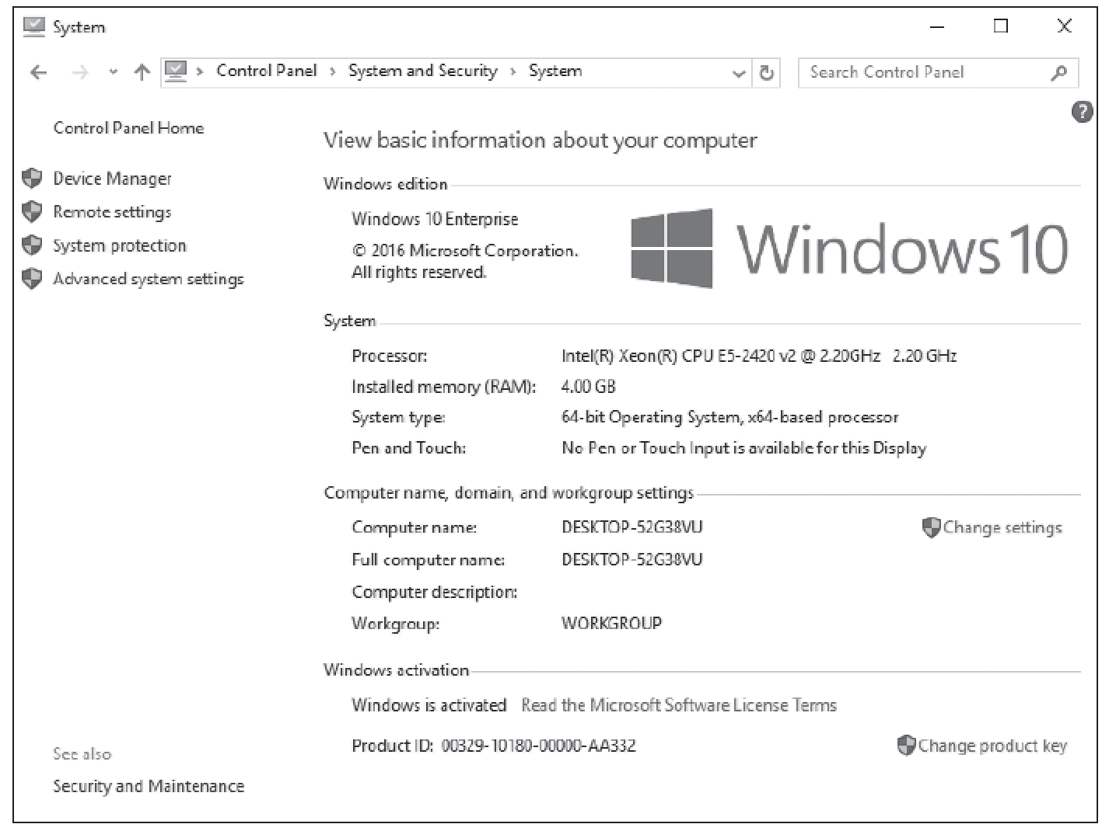
Configuring System Options (2/2)

Slide 20
Changing Date and Time
One of the easiest but most essential Windows tasks is making sure that the computer has the correct date and time, which is essential for logging purposes and for security.
If a secure packet is sent with the wrong date or time, the packet may be automatically denied because the date and time are used to determine whether the packet is legitimate.

Slide 21
Configuring Desktop and Taskbar Settings
Windows desktop settings is a broad term that refers to many different settings you can configure to personalize Windows, such as the Windows theme, the desktop background, mouse clicks and pointer speeds, gadgets, shortcuts, and more.
All settings are customizable—choosing the right mix will make your Windows experience more enjoyable and more productive.

Slide 22
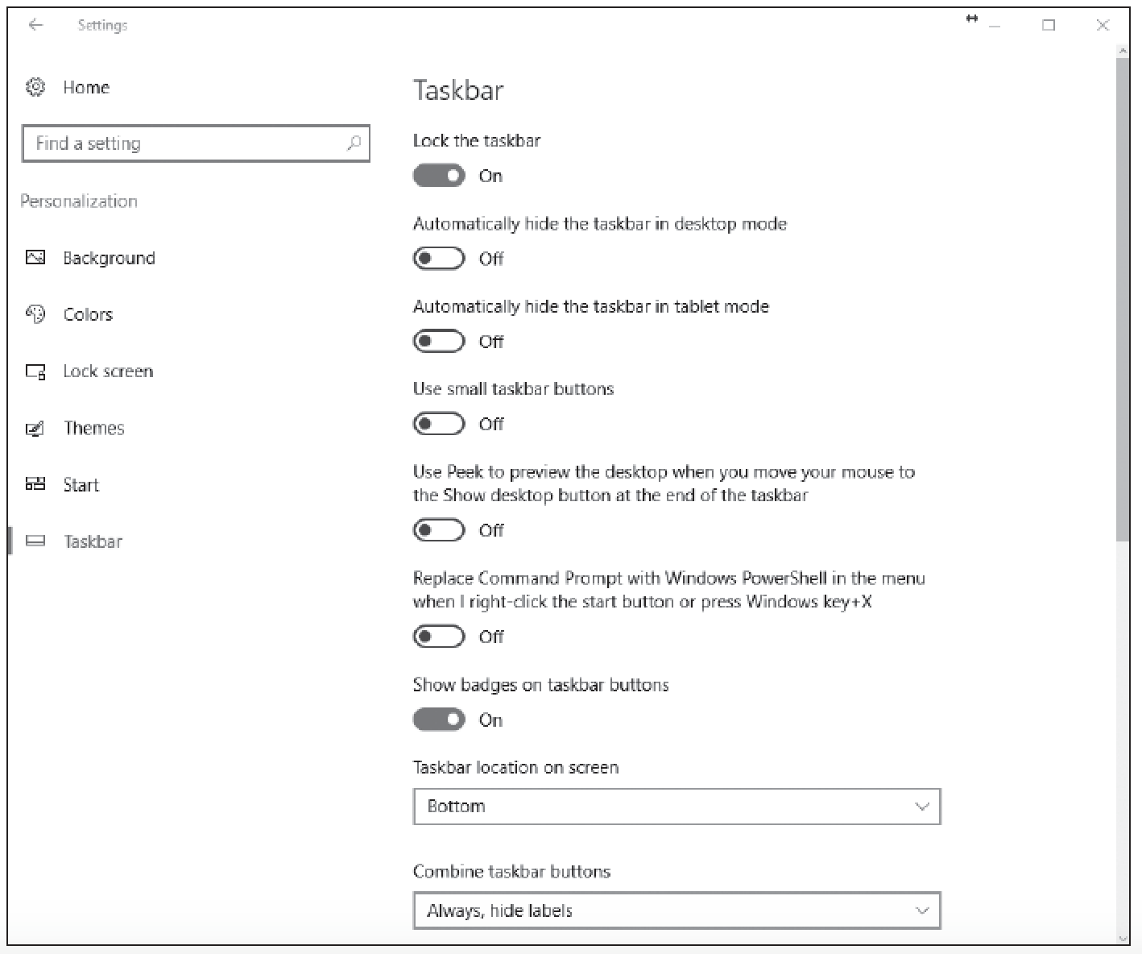
The Taskbar Page

Slide 23
Configuring File Explorer Settings
File Explorer, previously known as Windows Explorer, is the file manager that is included with Windows operating systems.
It provides a graphical user interface to access and manage the file system, including opening files, moving and copying files, and deleting files.

Slide 24
Configuring User Profiles (1/2)
When a user logs on to Windows, the user has a user state that is captured in the user’s profile.
A user state is the collection of data and settings that pertain to each user. It describes settings and data that determine the user environment.

Slide 25
Configuring User Profiles (2/2)
The user state separates the user environment, files, and settings from the files and settings that are specific to the installed operating system and those that belong to installed applications.
When a user logs on, the user state is kept separate from other users on the same computer. The user state includes users’ data and their application or operating system configuration settings.

Slide 26
Configuring Libraries
In Windows 10, a library is a virtual folder that can display content from different locations (folders, for example) on your computer or an external drive.
A library looks like an ordinary folder but simply points to files and folders that are located elsewhere. You access libraries in File Explorer, just like you do files and folders.

Slide 27
Configuring Display Settings (1/2)
Windows 10 has several display settings. The settings you’ll most likely modify include the resolution, color depth, and font size. You can modify each setting to suit a particular application.
When you right-click the desktop and choose Display Settings, the Display page appears, allowing you to change the orientation and the size of the text (see next slide).

Slide 28
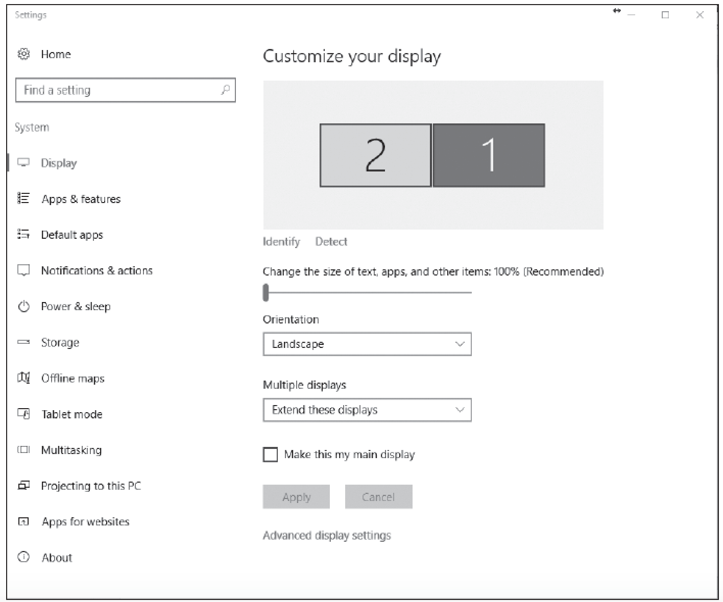
Configuring Display Settings (2/2)

Slide 29
Configuring Power Settings (1/2)
Power management settings are accessed by opening Settings and clicking System > Power & Sleep.
Screen settings allow you to specify how long the screen will remain on when you aren’t actively using your computer.
Sleep settings specify how long the computer will operate before going into sleep mode.

Slide 30
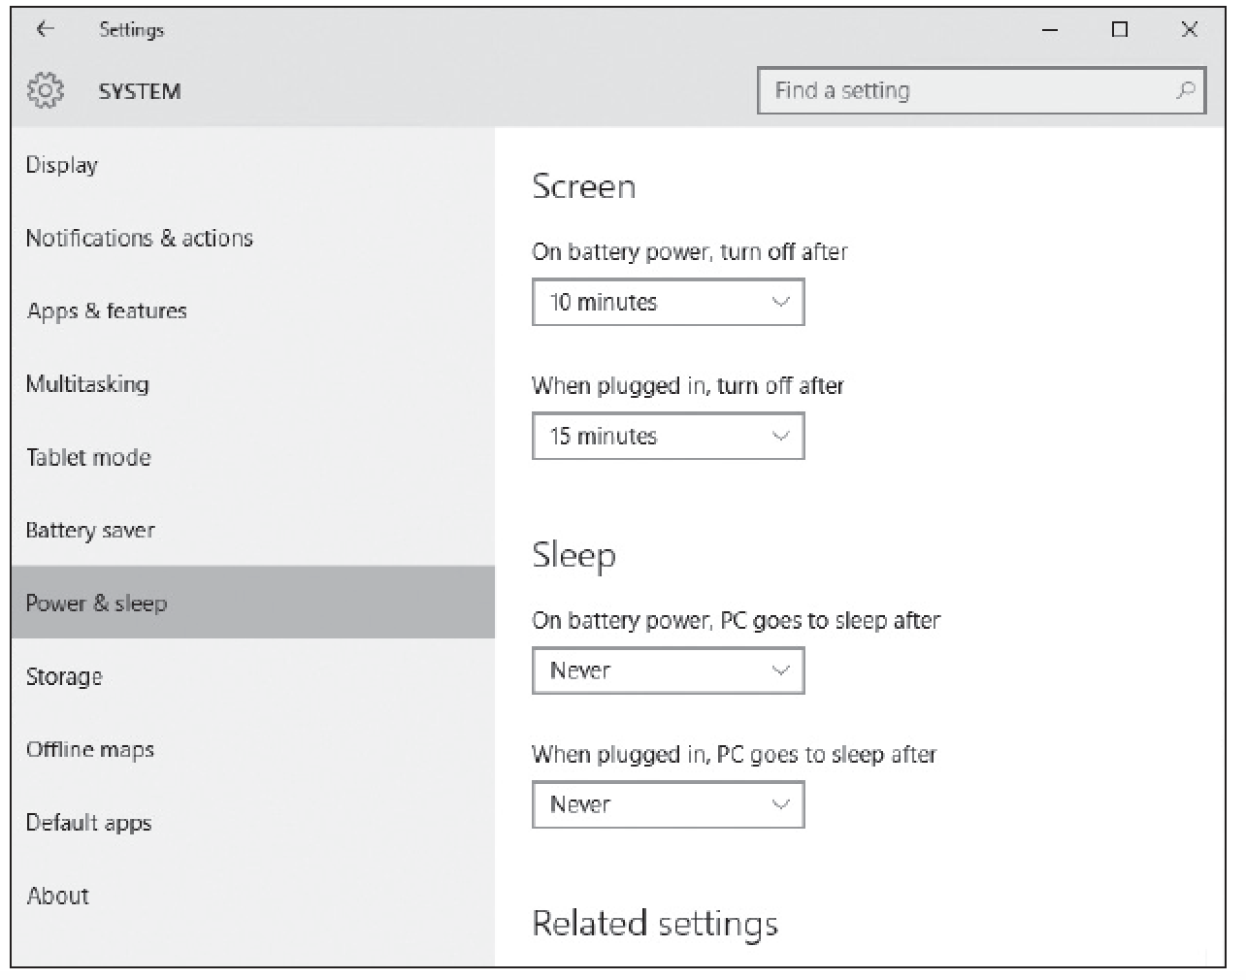
Configuring Power Settings (2/2)

Slide 31
Configuring Accessibility Options
Microsoft has built many features into Windows 10 that work with assistive technologies or as stand-alone features that improve the user experience for people who are deaf or visually impaired.
Most accessibility features can be configured in the Ease of Access Center.

Slide 32
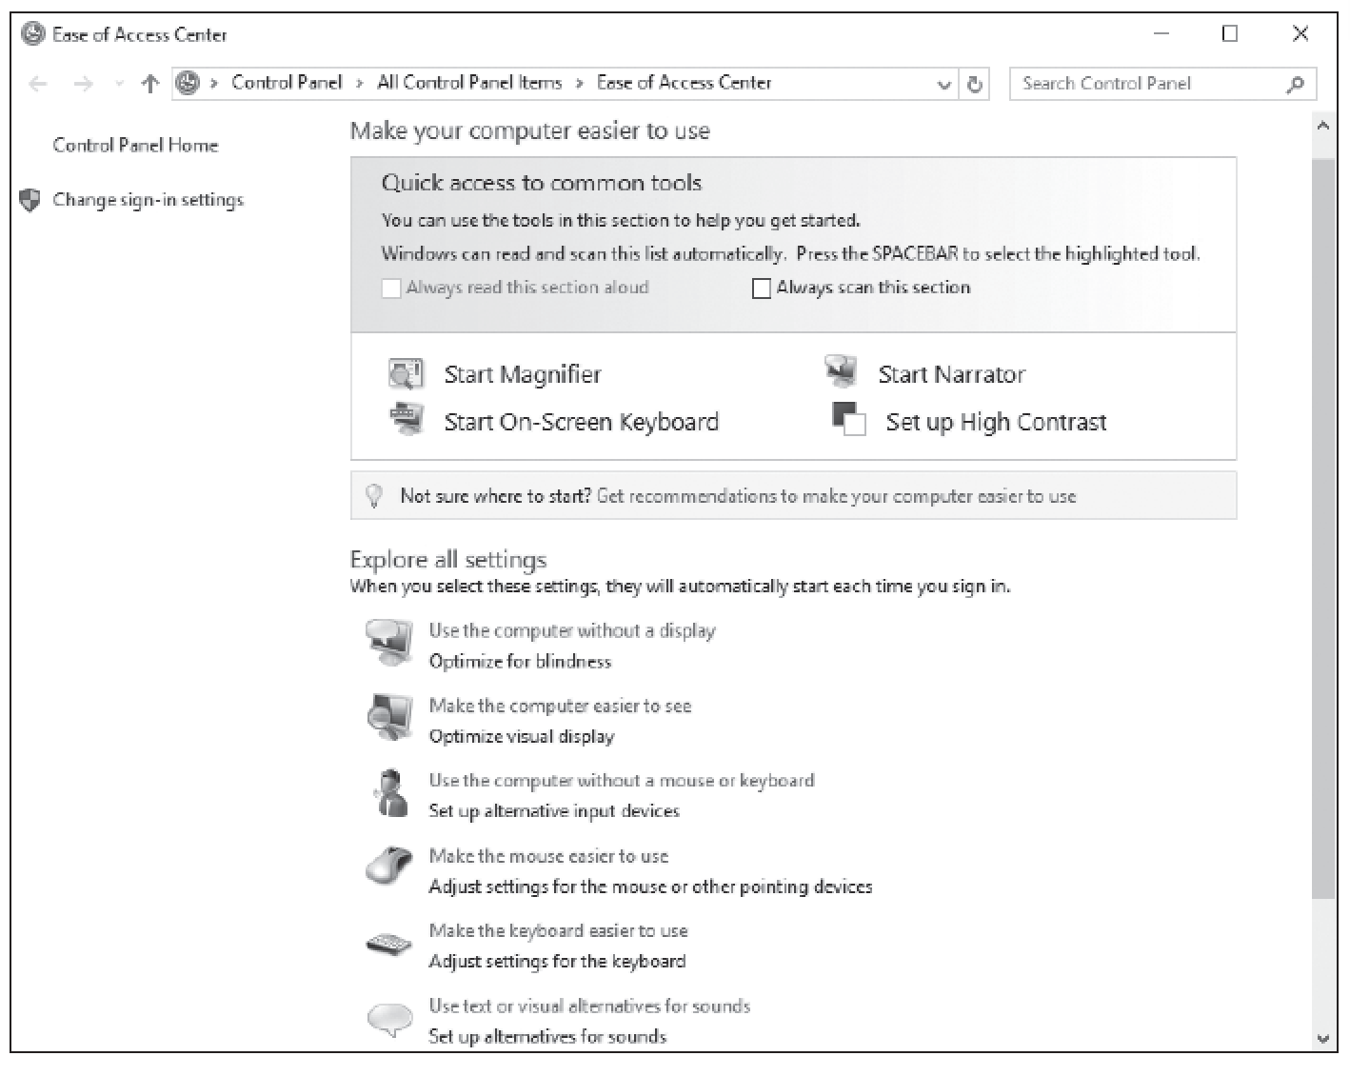
Ease of Access Center

Slide 33
Creating and Managing Shortcuts
Shortcuts are icons you can click to start a program or go to a location without requiring any extra steps.
Shortcuts save time because you don’t have to use several keystrokes or click several menus or commands.

Slide 34
Virtualization
A technology that creates an abstract version of a complete operating environment (including a processor, memory, storage, network links, a display, and so forth) entirely in software.
Software produces a virtual computer or a virtual machine (VM).
Has guest operating system.

Slide 35
Configuring Hyper-V
Client Hyper-V enables you to create and manage virtual machines (VMs) using a virtual switch.
These VMs can be used to test your applications for compatibility with new operating systems, allow you to run applications written for older versions of Windows, or isolate an application.

Slide 36
Creating and Configuring Virtual Machines
A virtual machine (VM) is a self-contained, isolated unit that can be easily moved from one physical computer to another, runs its own operating system, and includes its own virtual hardware configuration.

Slide 37
Creating and Managing Virtual Disks
A virtual disk is a file that represents a physical disk drive to a guest operating system running on a virtual machine.
The user can install a new operating system onto the virtual disk without repartitioning the physical disk or rebooting the host machine.

Slide 38
Creating and Managing Checkpoints (1/2)
In Hyper-V, a checkpoint is a captured image of the state, data, and hardware configuration of a VM at a particular moment in time.

Slide 39
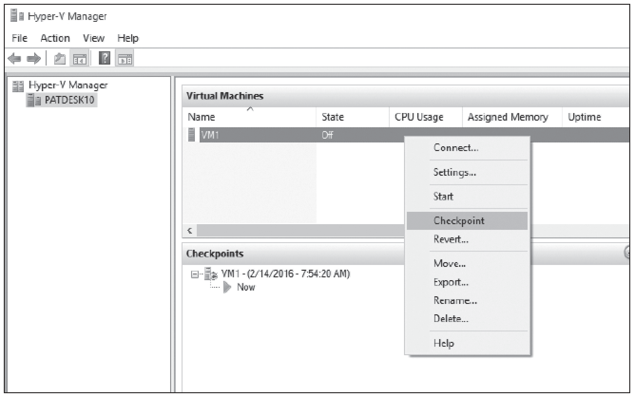
Creating and Managing Checkpoints (2/2)

Slide 40
Summary (1/5)
The desktop is the main screen area that you see when you first start the computer and log on to Windows.
Like the top of an actual desktop, it is where you perform your work by opening and running one or more applications.
It also includes the Recycle Bin, which is used to recover files that have been previously deleted.
In Windows 10, many of the Windows configuration is done within Settings. Settings can be accessed by clicking Start > Settings.

Slide 41
Summary (2/5)
With versions of Windows prior to Windows 10, Control Panel was the primary graphical utility to configure the Windows environment and hardware devices.
In Windows 10, it can be accessed by right-clicking Start and choosing Control Panel.
File Explorer, previously known as Windows Explorer, is the file manager that is included with Windows operating systems.
It provides a graphical user interface to access and manage the file system including opening files, moving and copying files, and deleting files.

Slide 42
Summary (3/5)
In Windows 10, a library is a virtual folder that can display content from different locations (folders, for example) on your computer or from an external drive.
A library looks like an ordinary folder but simply points to files and folders that are located elsewhere.
In Windows 10, simple power management settings can be accessed by opening Settings and clicking System > Power & Sleep.

Slide 43
Summary (4/5)
Screen settings allow you to specify how long the screen will remain on if you are not actively using your computer when the computer is using battery power or when it is using AC power (plugged in).
Sleep settings will specify how long the computer will operate before going into sleep mode when the computer is using battery power or when it is using AC power.
Microsoft has built many features into Windows 10 that work with assistive technologies or as stand-alone features that make the user experience better for people who are deaf or visually impaired.

Slide 44
Summary (5/5)
Most accessibility features can be configured in the Ease of Access Center.
Client Hyper-V enables you to create and manage virtual machines (VMs) using a virtual switch.
These VMs can be used to test your applications for compatibility with new operating systems, allow you to run applications written for older versions of Windows, or isolate an application.
The physical machine that Hyper-V and the virtual machines run on is often referred to as the host.

